Slide 1


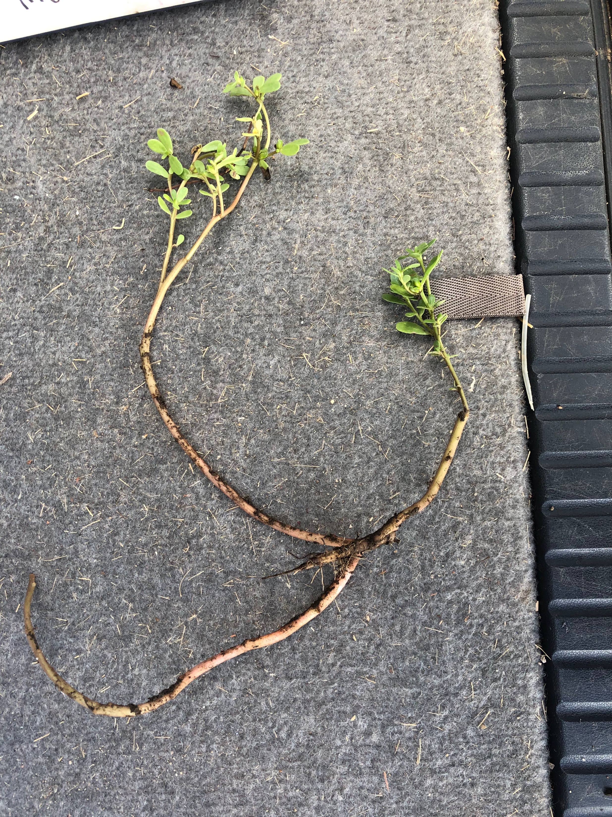
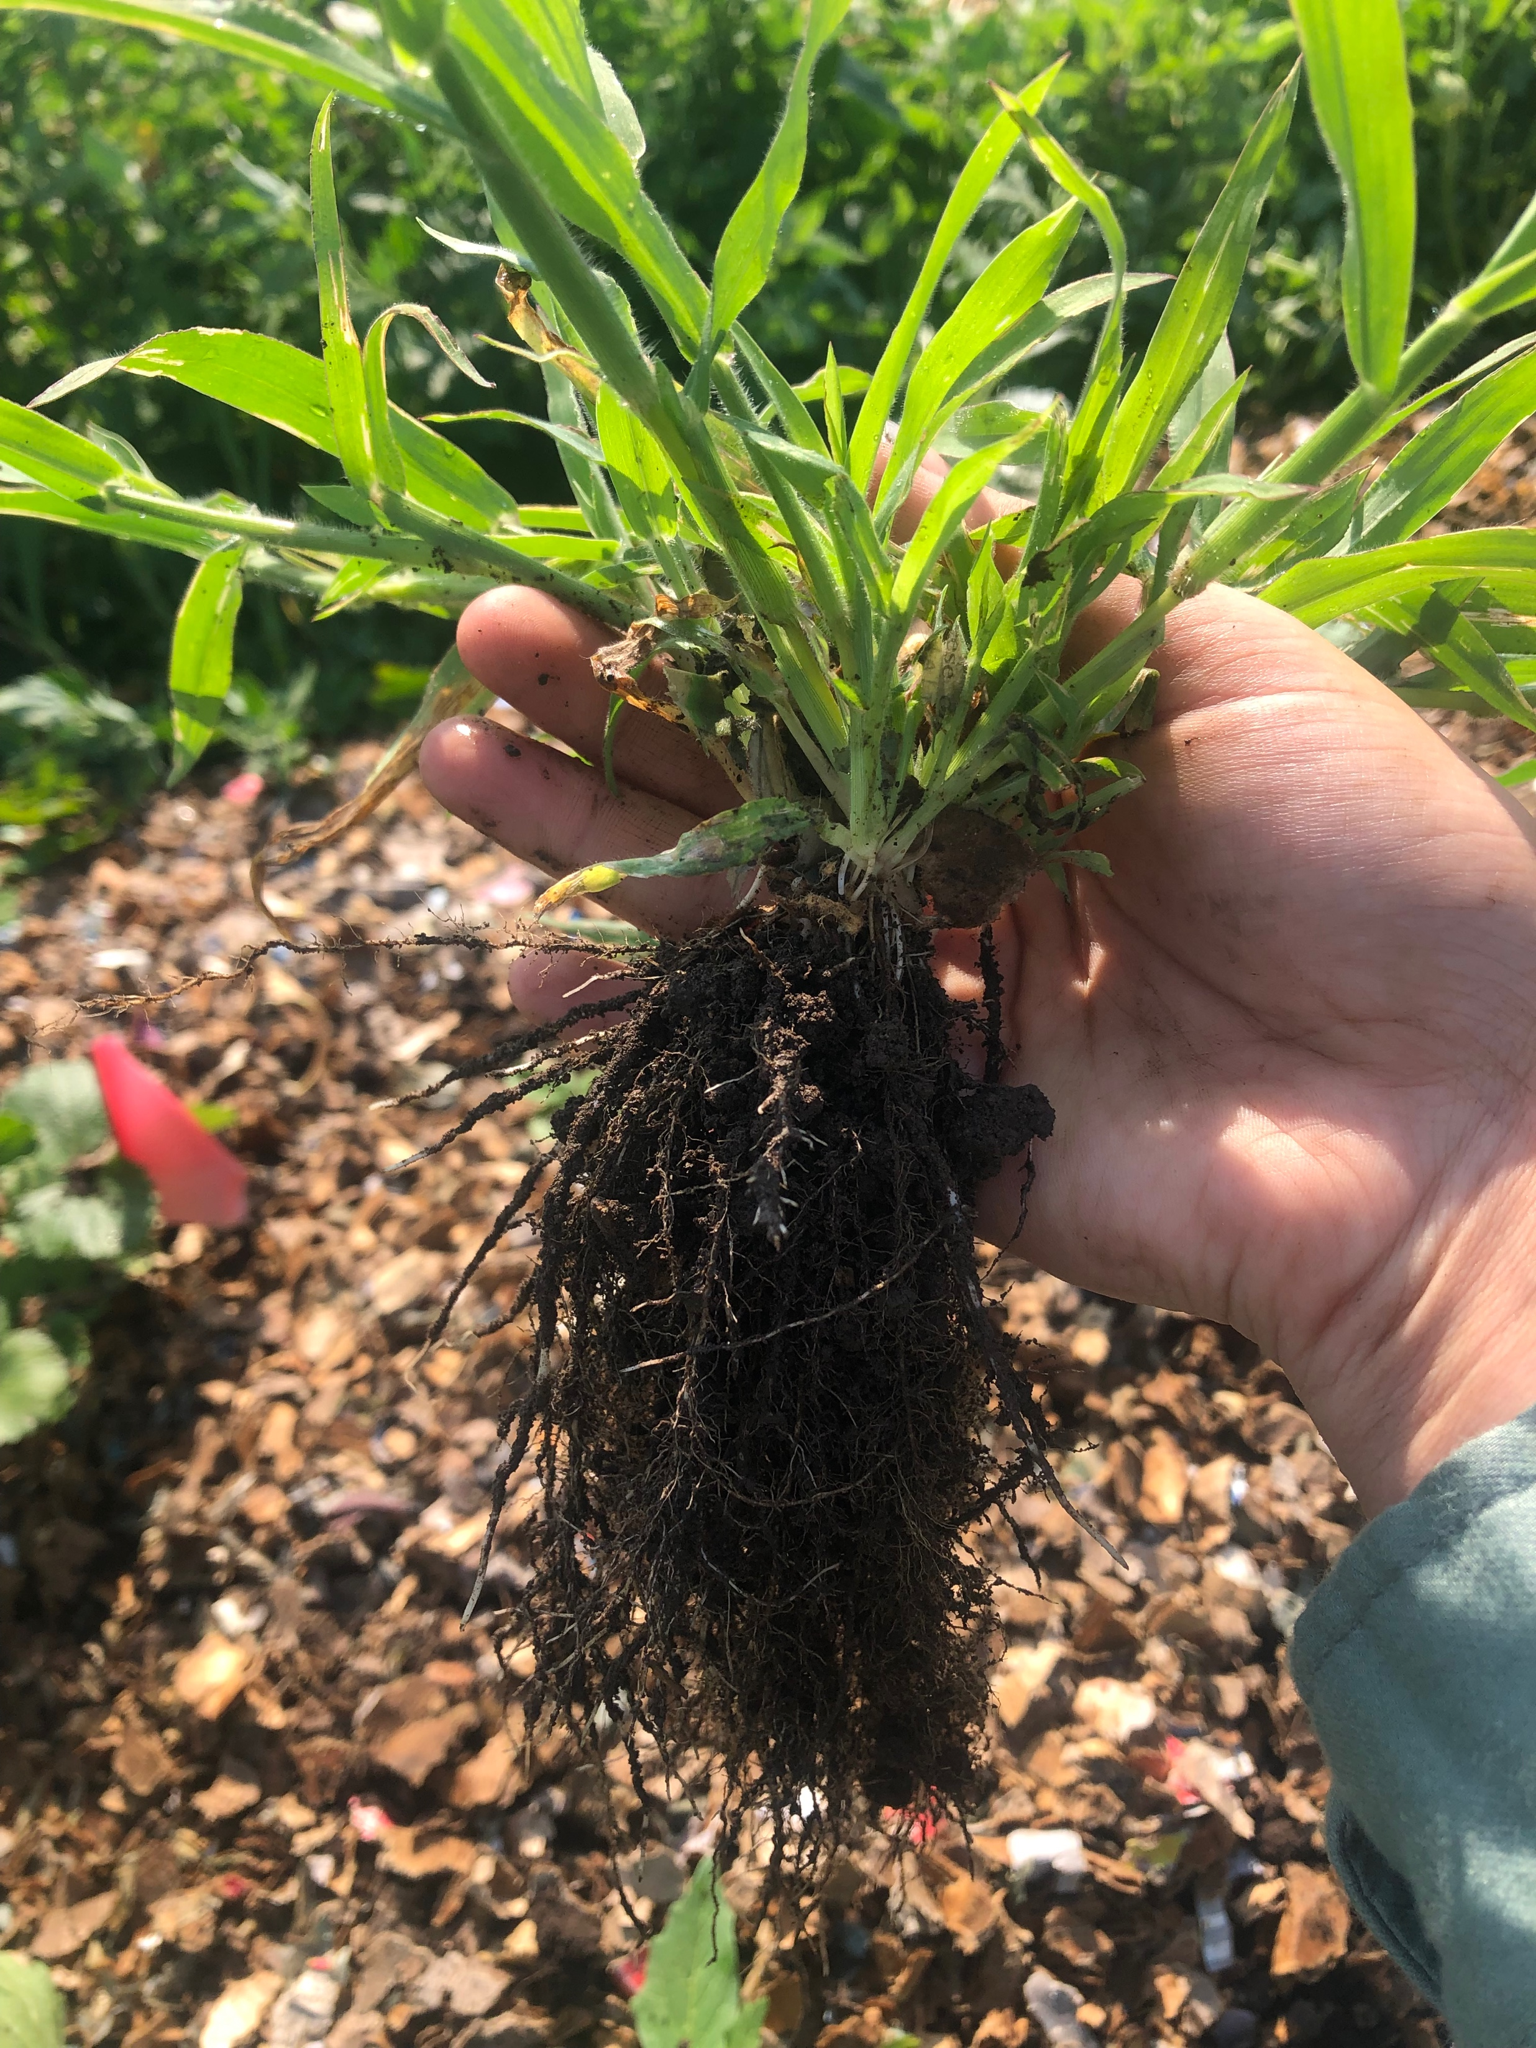
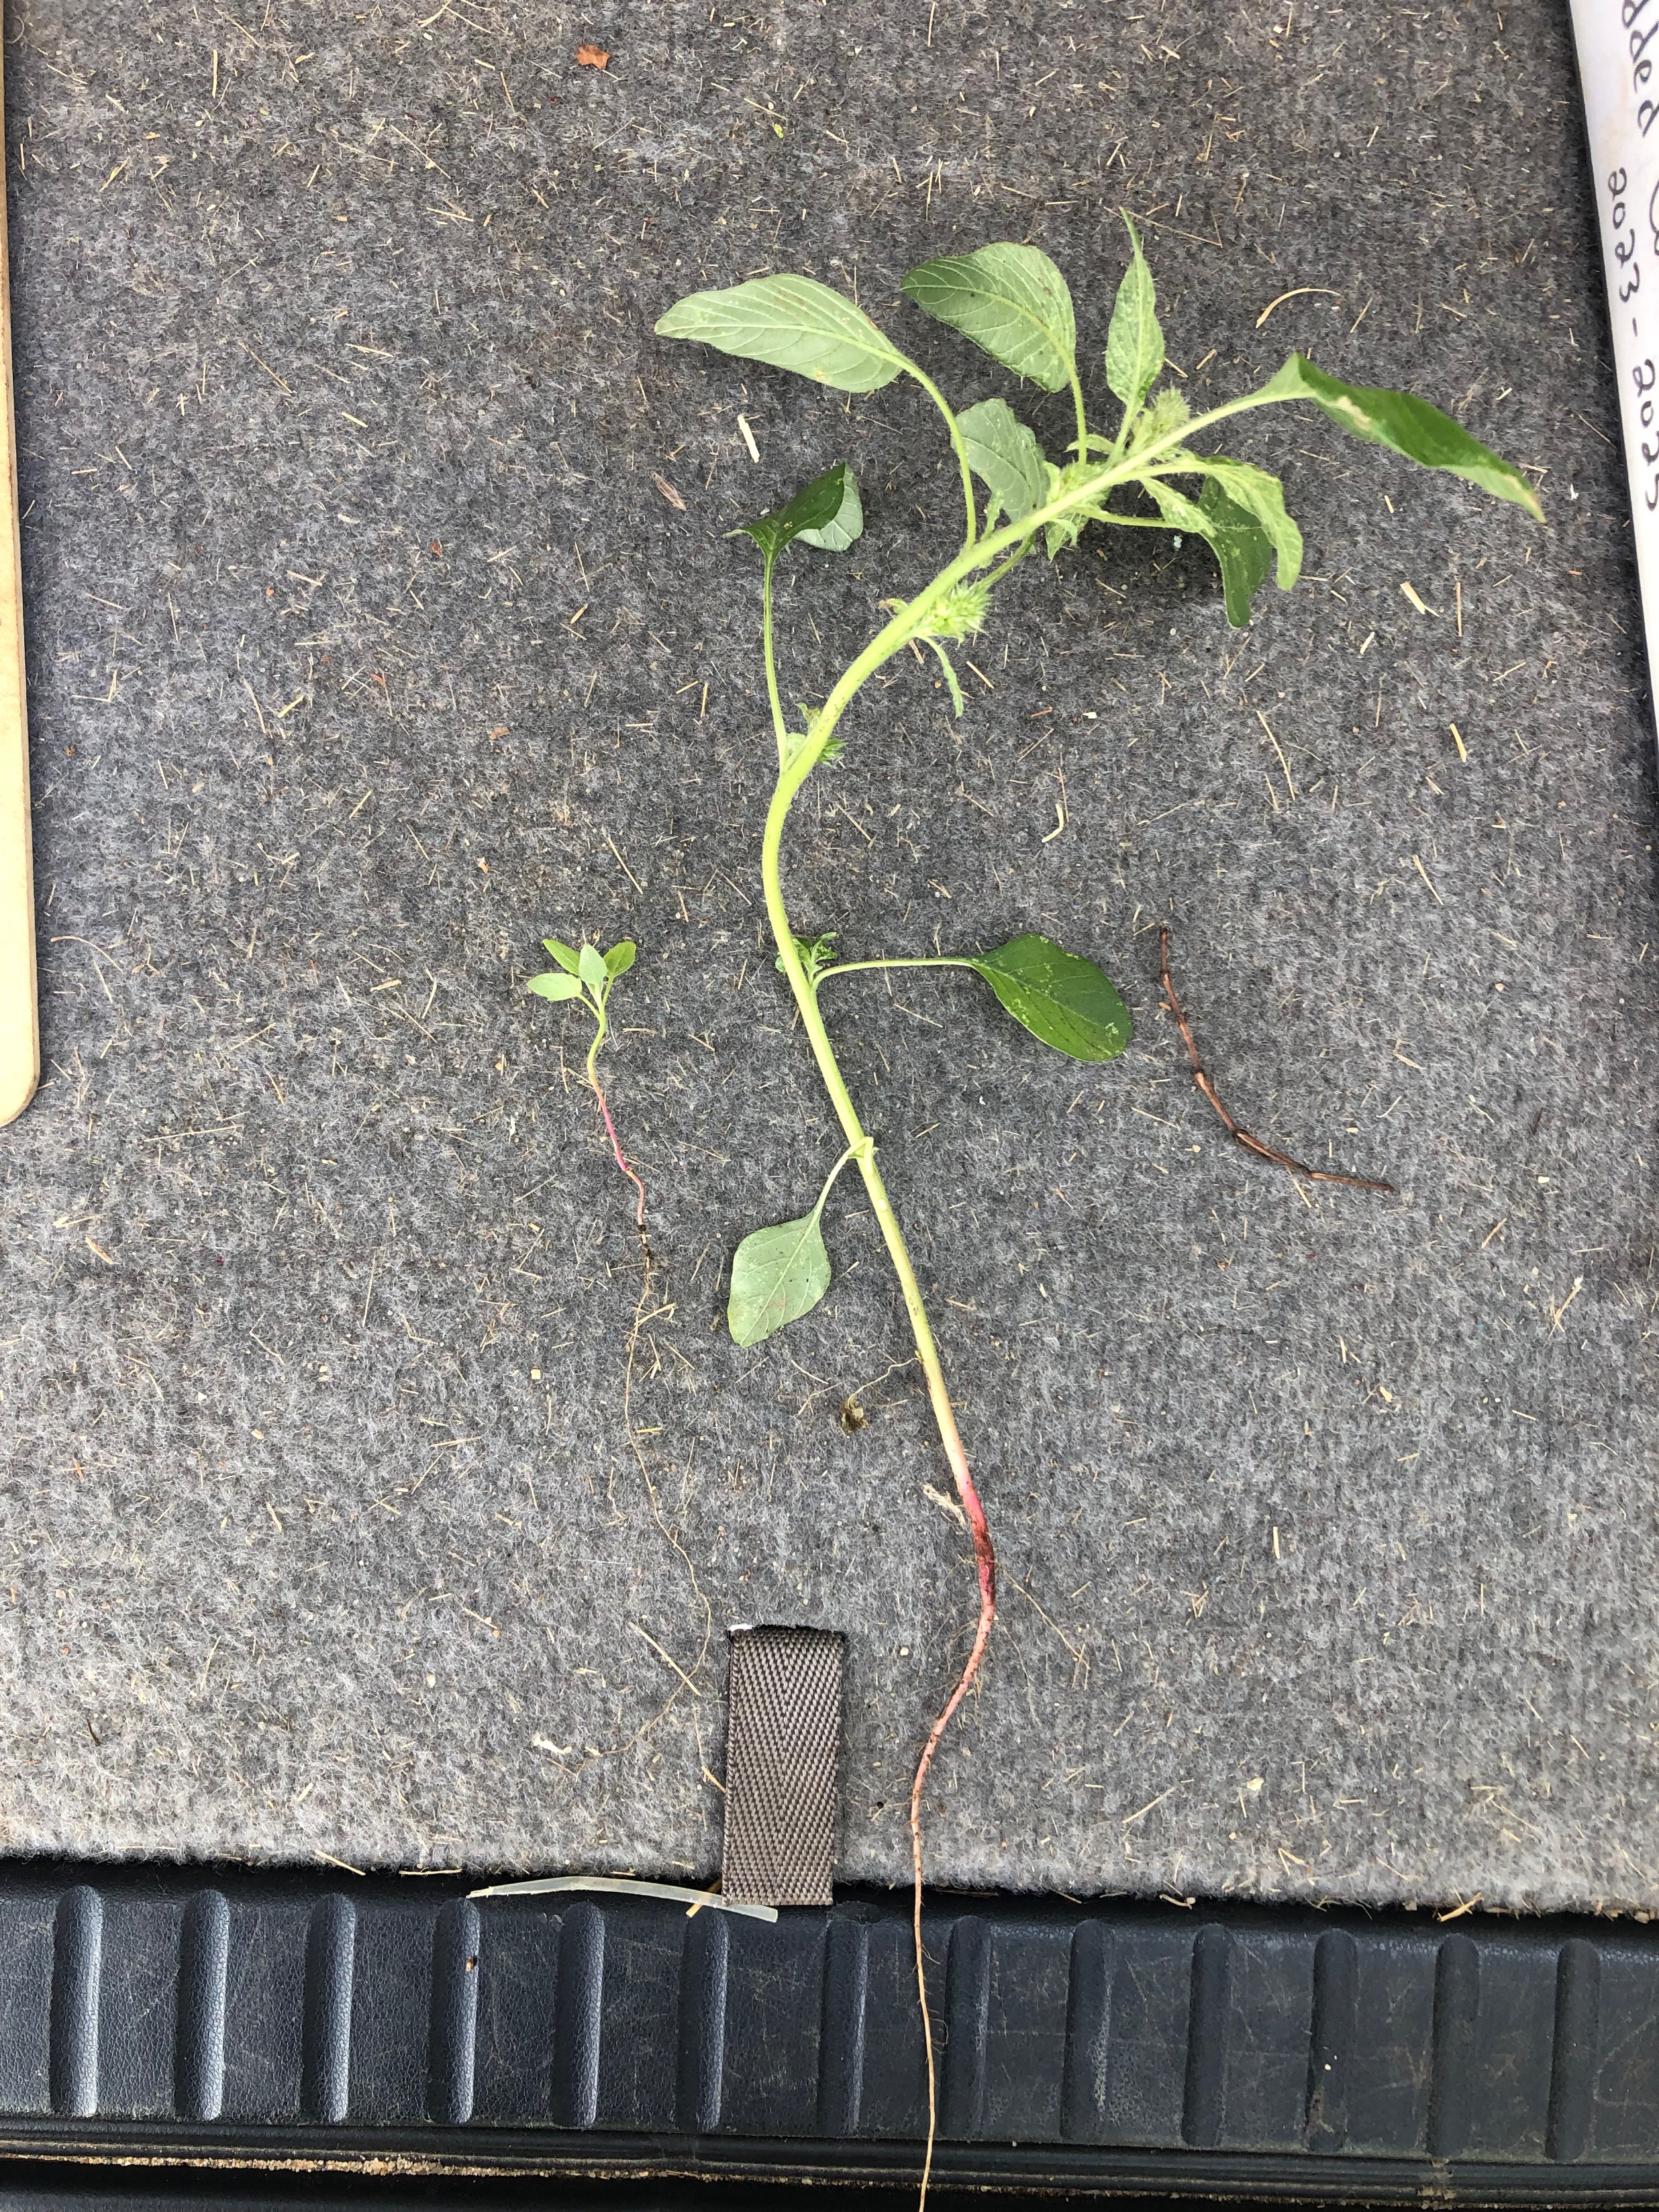
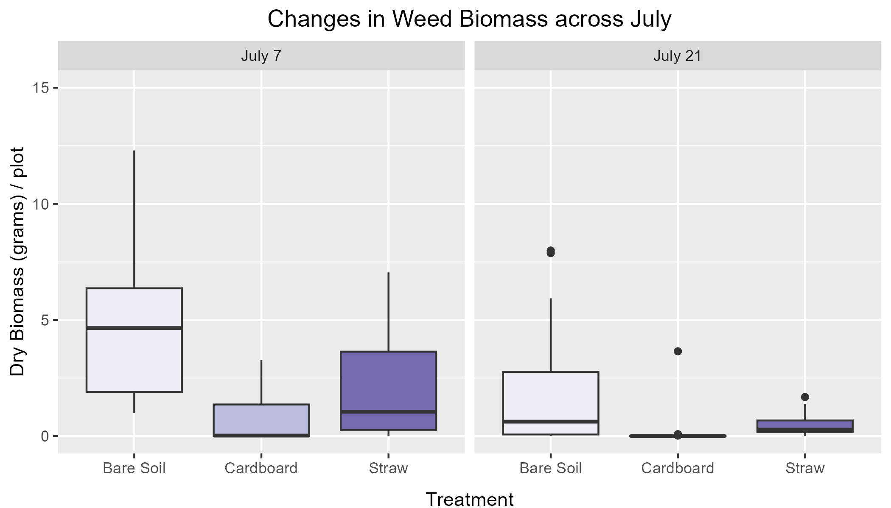
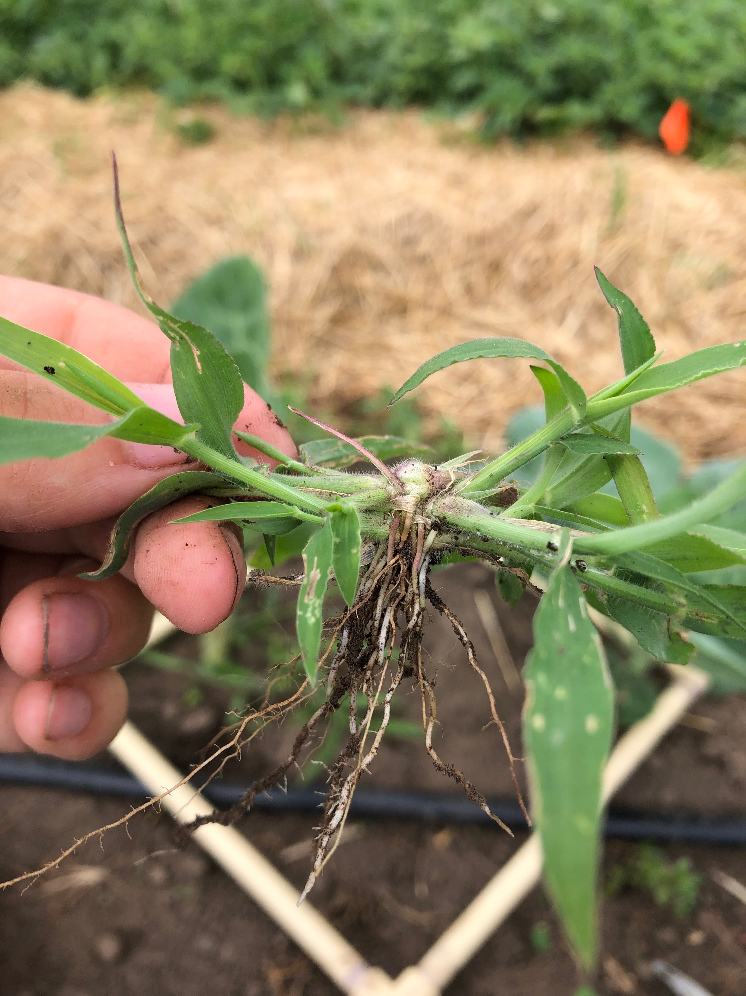
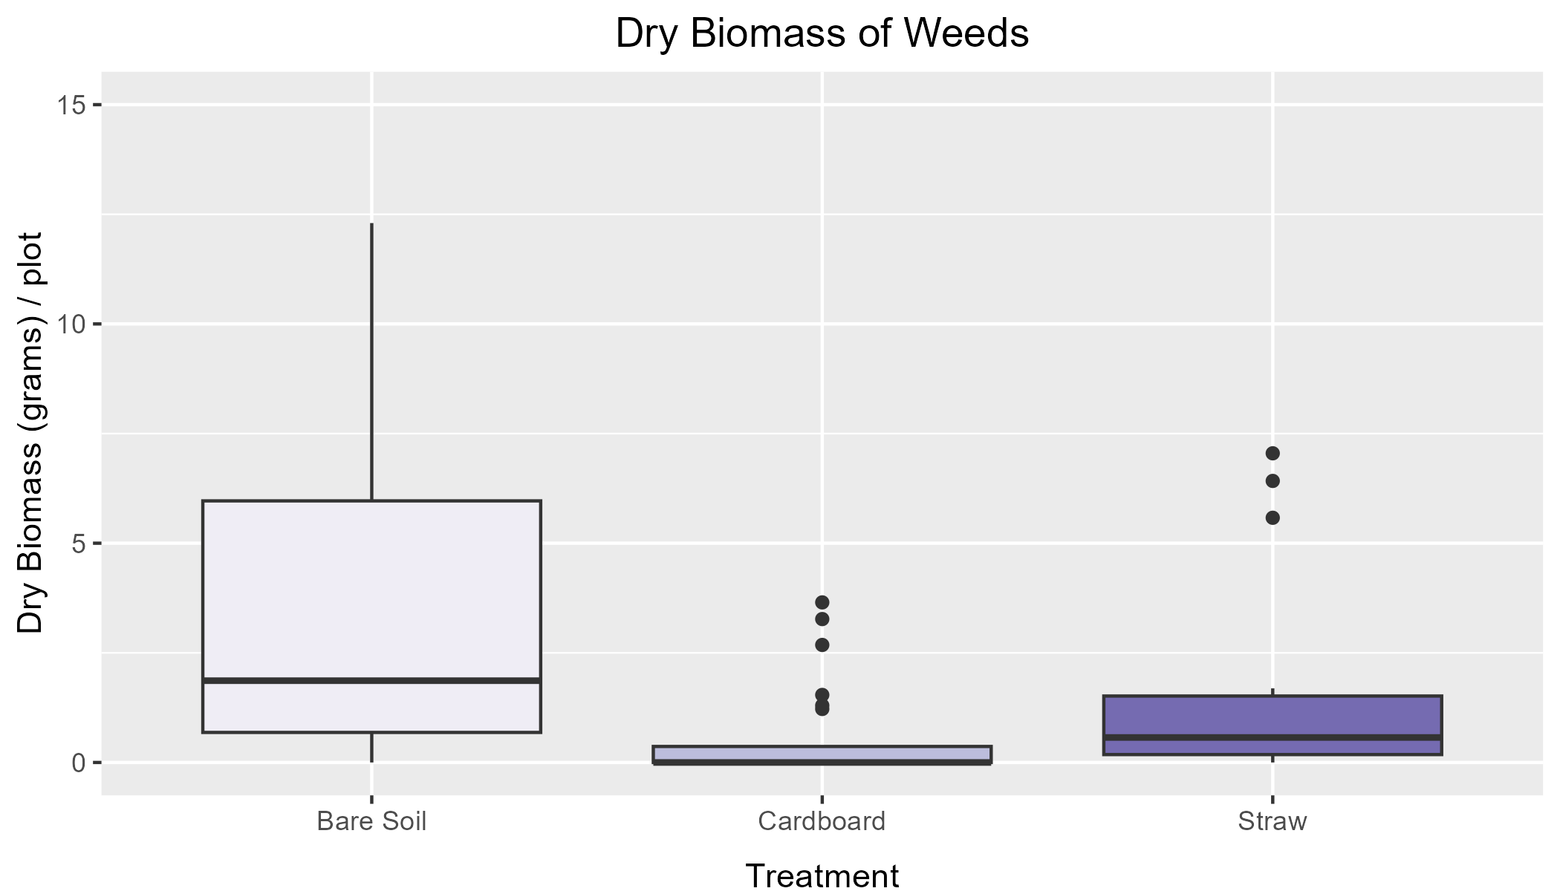
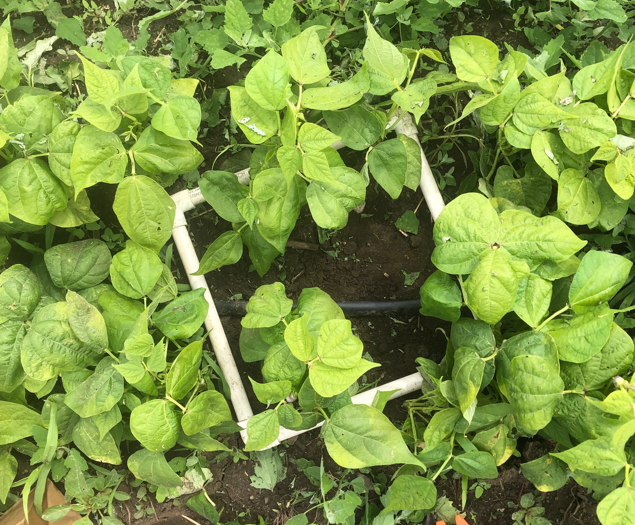
Weeds as neighbors: exploring plants that grow despite mulches to understand relationships between plants, land, and growers in urban agriculture
Cecilia Cole¹, Jennifer Nicklay², Nora Pearson², Mary Rogers³, and Nic Jelinski²
Augsburg University, Minneapolis, MN 2.Department of Soil, Water, and Climate, University of Minnesota - Twin Cities, St. Paul, MN 3.Department of Horticultural Science, University of Minnesota - Twin Cities, St. Paul, MN
Introduction
Results- Plant Stories
Results- Quantitative Data
Purslane
Purslane is a popular edible “weed” that is full of dietary minerals and omega 3s. The small seed, produced by the thousands, needs sufficient water in the soil to germinate and push the small red stem out of the soil. When the small seedling gets enough light and enough water, it grows out its red stem and pops out a couple thick characteristically succulent leaves, thick, squishy and full of water. The small seedling branches out in a cluster with the growing tap root. The clusters get quite large and grow quite long. Purslane seems to struggle to get enough light in both straw and especially cardboard mulch, but in the bare soil , it seems to thrive. The cardboard mulch forces its inhabitants to stretch out underground a bit until it can put out any leaves. https://hort.extension.wisc.edu/articles/common-purslane-portulaca-oleracea
Mulch is one strategy that urban farmers and gardeners use mulch to suppress weeds, maintain water moisture, and reduce the amount of time required for weeding. Traditional mulches like straw, however, can be expensive and difficult to transport, so urban growers in St. Paul, MN are interested in using a new material – shredded cardboard – because it is low-cost and could be produced locally. This research project explores three questions:
1) What is the impact of the type of mulch on the amount of weed biomass? 2) What types of weed are emerging through mulch? 3) How do the types of weeds present help us understand the mulch, the land, and our growing practices in relationship with each other?
Amount of weeds per species
Graph 1. highlights the amount of weeds and the different species pulled during Weed Biomass Sampling. Seeing the different species next to each other shows up the differences in quantity between the species of “weeds”. Grasses are observed more frequently, with Lambs Quarter coming second.
Lambs Quarter
Lambs Quarter is found in our plots everywhere, while they at most grow up to a foot tall, they usually are found at 3 feet tall. As abundant as they are, they are also nutritional. As we irrigate its home, it starts to germinate and push its way through to the light, its two leaves, pink facing the ground and the green side taking in the wonderful sunlight. After the stem and root system have grown to an adequate size, the leaves grow alternatively reaching for the sun one arrow shaped leaf at a time. Lambs Quarter, if it can push its way through to the sun in the cardboard, it will. The cardboard mulch is about two inches thick, which seems to be the right height to discourage the growth of the illustrious Lambs Quarter. In the straw and bare mulch treatments plots, the lambs quarter seem to grow unadulterated. The colorful stems of a grown Lambs Quarter require a significant portion of nitrogen in order to grow. Because the Shredded Cardboard adds Carbon into the soil through its decomposition, this could become troublesome.
https://blogs.cornell.edu/weedid/common-lambsquarters/
Changes in weed biomass across July
Graph 2. shows us the differences between each Mulch treatments and the amount of weeds each Biomass Sampling Session throughout July. Our preliminary results indicate that shredded Cardboard Mulch is an adequate mulch to keep down weeds and Straw is a good alternative.
Methodology
The research project took place at the University of Minnesota St. Paul Agriculture Experiment Station. Straw and shredded cardboard were used for mulch treatments, and bare soil was used as a control. Three crops – ‘Albion’ strawberries, ‘Flash’ collards, and ‘Dragon-tongue’ bush beans – were grown for each treatment. Each crop*mulch treatment was replicated four times.
After mulch was applied on June 22nd, weed biomass and weeding time were measured every two weeks. To measure the biomass of weeds, a 0.1m² quadrat was randomly placed in each plot. We pulled and snipped the roots off all weeds growing within the quadrat. Afterwards, the weeds are added to an oven at 140 degrees F for multiple days until crispy and weighed at its dry mass. To measure the time required to complete weeding, the start and end time for one person to weed each plot was recorded. Weed species ID was completed only for one set of crop*mulch replicates due to time constraints. Stories about the weeds were developed through observations and a Literature Review to assist in the understanding of the relationships between the plant and its habitat.
Barnyard Grass
Barnyard grass is non-native to this region and is from the New England area. The flat, small blade of grass pushes its way through the soil with ease as its fibrous root system makes its way through the soil to find the nutrients if needed. While small at first, once the grass grows many more blades, those roots really branch out. Because the cardboard mulch creates a kind of shell and is too tightly packed that the small and flimsy blade of grass, it is too hard for the grass to reach for the sun, although, if the original small blade makes it through, the rest is quite easy as there is more than enough water and little to no competition. The straw and bare soil plots offer the grass much space to grow deep into the soil, and the original blade pushes and slips its way past the straw to grow up tall enough to flatten out.
https://gobotany.nativeplanttrust.org/species/echinochloa/crus-galli/
Dry biomass of weeds
Graph 3. Compares the total weed biomass for each treatment. Preliminary results indicate that shredded cardboard significantly reduces weeds compared to bare soil.
Acknowledgments
This project was supported by the NIFA-REEU Project 2021-10356. As well as my mentors Nora Pearson and Jennifer Nicklay for the support and assistance throughout this whole summer.

